Slide 1
Starry nigth

Slide 2
Create this universe
We received this assignment:
- The background should be black
- The stars can be small squares
- The stars should have random positions on the canvas
- The stars should have random color (some shade of grey)

Slide 3
I created my own universe
- black background OK
- stars are small squares? I think that NO ☺
- random positions on canvas OK
- stars have only shades of gray? NO ☺

Slide 4
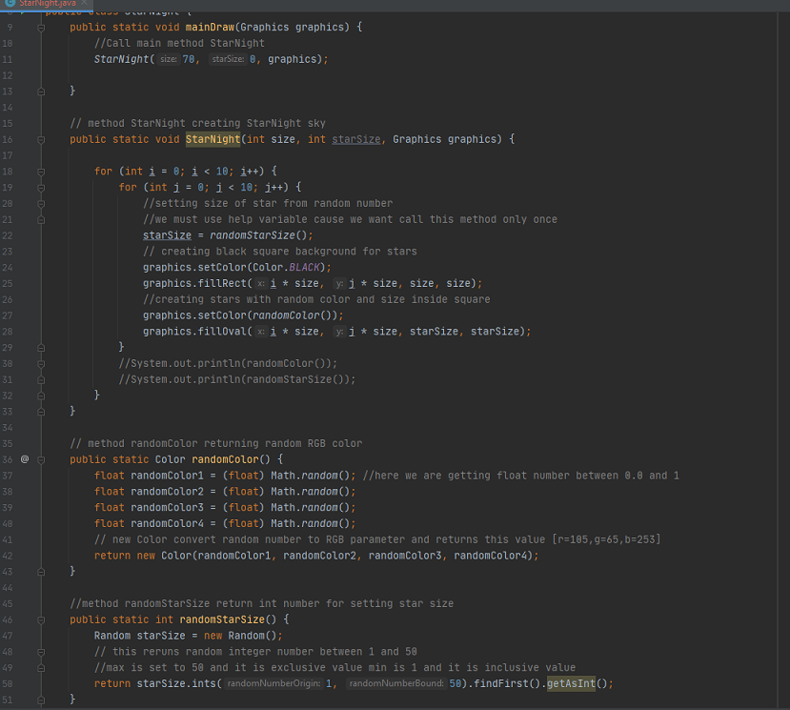

Slide 5
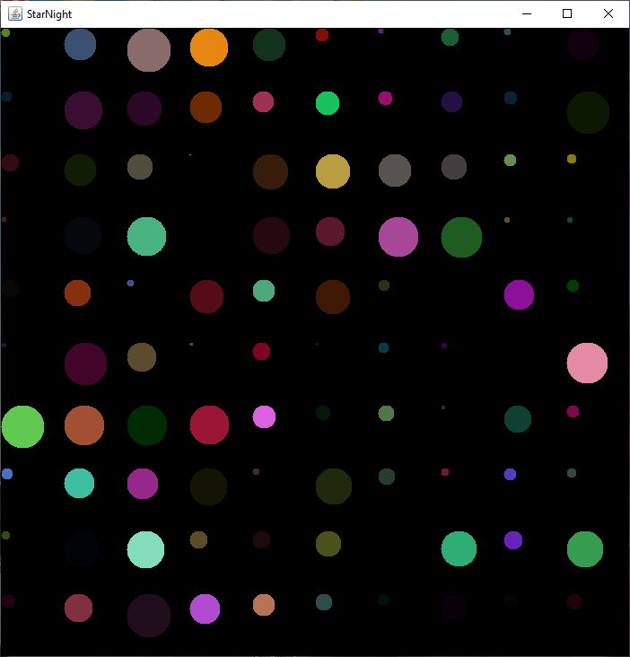

Slide 6
